Slide 1
Mortgage Refusal Rate Discrimination
STAT 3321 Case I
Summer 2006

Slide 2
Question
Is there a difference in the mortgage refusal rates between whites and other minorities?

Slide 3
Conclusion
Based on this sample data there appears to be strong mortgage refusal rate discrimination.
The refusal rate for minorities is 21.3% higher for minorities when compared to whites in the average income group.
Even when we compare high income minorities to high income whites we still find a difference in refusal rates of 16.2%.

Slide 4
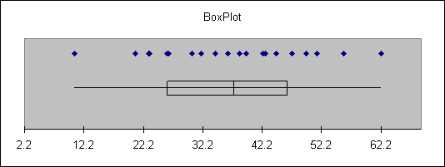
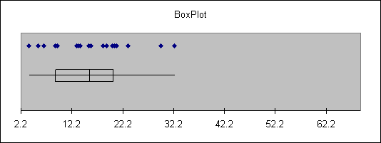
Comparative Boxplots
Minority
White

Slide 5
Analysis
The average refusal rates for minorities in this sample is 39.6%.
The average refusal rate for whites in this sample is 15.6%.
This is a difference of 21.3%.
That is, in this sample, minorities have a rejection rate that us 21.3% greater than whites.

Slide 6
Counter Argument
The banks contend that the refusal rates for minorities are higher because of their economic status which result in the mortgage application being turned down for economic reasons.

Slide 7
Checking the Bank’s Claim
We can check this claim by looking at refusal rates high income minorities.
If the bank’s claim is correct than the mortgage refusal rates for minorities should be approximately equal to mortgage refusal rates for whites.

Slide 8
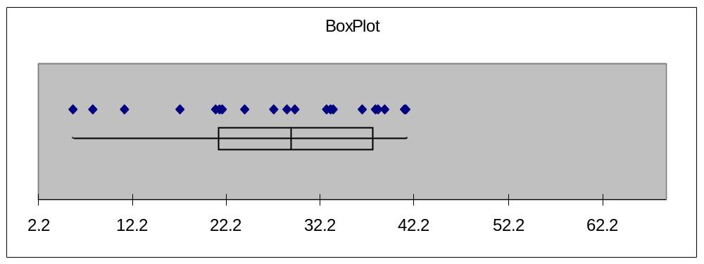
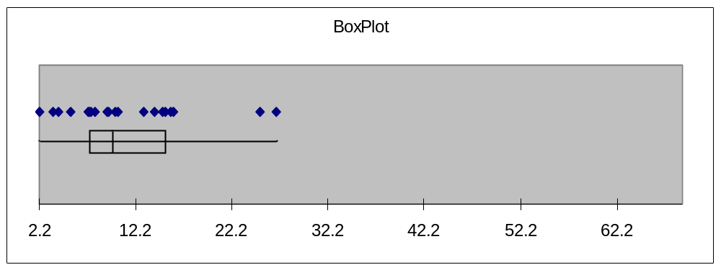
Boxplots for High Income
Mortgage Applications
High Income
Minority
High Income
White

Slide 9
Analysis of High Income Mortgage Refusal Rates
The average refusal rates for high income minorities in this sample is 27.5%.
The average refusal rate for high income whites in this sample is 11.3%.
This is a difference of 21.3%.
That is, in this sample, minorities have a rejection rate that us 16.2% greater than whites.

Slide 10
Limitations
We don’t know how the sample was collected. It may not be a simple random sample.
WE don’t yet have the inferential machinery that allows us to assess the probability of an inferential error.

